Slide 1

LINEAR REGRESSION AND CORRELATION ANALYSIS
SCATTER PLOTS AND CORRELATION
SIMPLE LINEAR REGRESSION ANALYSIS
USES FOR REGRESSION ANALYSIS

Slide 2
WHY NEED TO KNOW?
Regression and correlation analysis are most used statistical procedure used by business decision makers for analyzing the relationship between two variables.
Common visual tool for two-variable relationship: scatter plots (or scatter diagram)
Scatter plot: A two-dimensional plot showing the values for the joint occurrence of two quantitative variables.
Dependent (response) variable, y – a variation wish to explain
Independent (explanatory) variable, x – used to explain variation in dependent variable

Slide 3
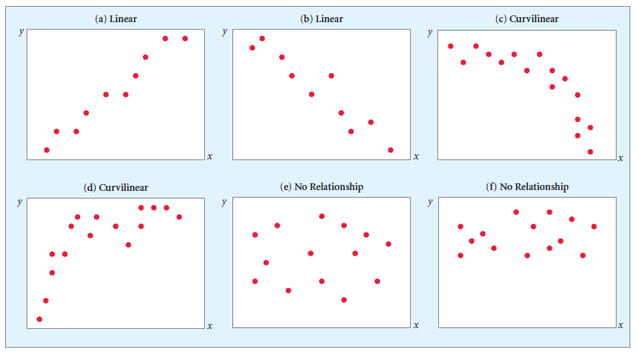
Two- variable relationship
and (b) examples of strong linear (or straight line) relationships between x and y
(c) and (d) examples of relationship between the x and y variable is nonlinear.
(e) and (f) examples in which there is no identifiable relationship between the two variables. This means that as x increases, y sometimes increases and sometimes decreases but with no particular pattern.

Slide 4

CORRELATION ANALYSIS
What can we measure?
Strength of the relationship: weak, moderate or strong
Direction of the relationship: positive or negative or no relationship
Significance test for correlation: correlation exists or not

Slide 5
CORRELATION COEFFICIENT
A quantitative measure of the strength of the linear relationship between two variables.
The correlation ranges from -1.0 to +1.0.
A correlation of 1.0 indicates a perfect linear relationship
A correlation of 0 indicates no linear relationship.
The more correlation differs from 0.0, the stronger the linear relationship between the two variables.
Sign (+ or -) of the correlation coefficient indicates the direction of relationship

Slide 6
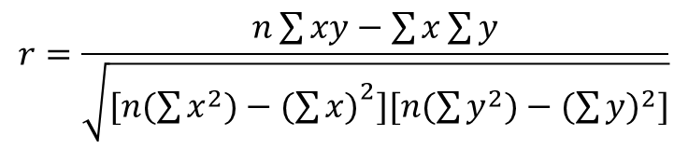
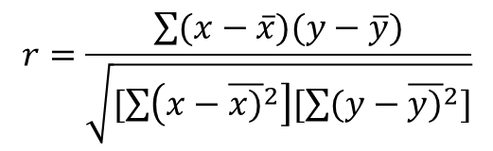
CORRELATION COEFFICIENT
$$r=\frac{n\sum{xy−\sum{x\sum{y}}}}{\sqrt{[n(\sum{x^{2})−({\sum{x)}}^{2}][n(\sum{y^{2})−(\sum{{y)}^{2}]}}}}}$$
$$r=\frac{\sum{(x−\overline{x})(y−\overline{y})}}{\sqrt{[\sum{\left({x−\overline{x)}}^{2}\right][\sum{(y−{\overline{y)}}^{2}]}}}}$$
OR
where:
r = Sample correlation coefficient
n = Sample size
x = value of the independent variable
y = value of the dependent variable
also called as Pearson Product Moment Correlation
However, because the calculations are rather tedious and long, need to have computer/statistical tool to perform the computation.

Slide 7
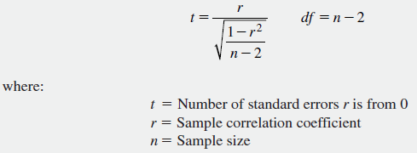
SIGNIFICANCE TEST FOR THE CORRELATION
What it is?: a hypothesis testing to determine whether there exists relationship between the variables.
Hypothesis: using the ρ (rho) notation
H₀: ρ = 0 (no correlation)
H_{A}: ρ ≠ 0 (correlation exists)
Test statistics for
correlation:

Slide 8
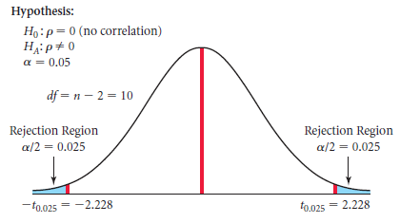
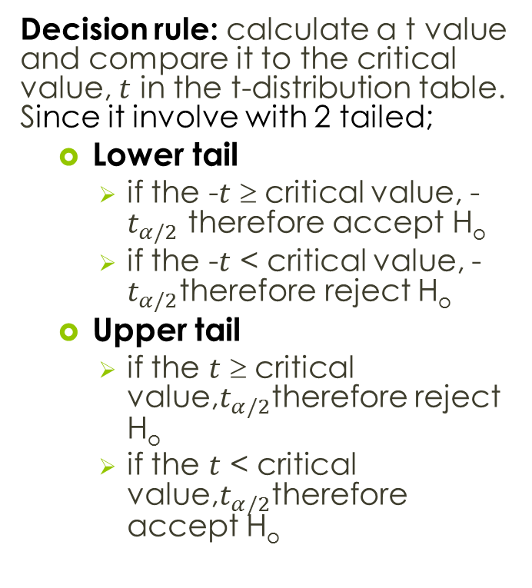
SIGNIFICANCE TEST FOR THE CORRELATION
Decision rule: calculate a t value and compare it to the critical value, $t$ in the t-distribution table. Since it involve with 2 tailed;
Lower tail
if the -$t$ ≥ critical value, -$t_{α/2}$ therefore accept H_{o}
if the -$t$ < critical value, -$t_{α/2}$therefore reject H_{o}
Upper tail
if the $t$ ≥ critical value,$t_{α/2}$therefore reject H_{o}
if the $t$ < critical value,$t_{α/2}$therefore accept H_{o}

Slide 9
CORRELATION ANALYSIS- EXAMPLE
A student intern at the investment firm of McMillan & Associates was given the assignment of determining whether there is a positive correlation between the number of individual stocks in a client’s portfolio and the annual rate of return for the portfolio. The intern selected a simple random sample of 10 client portfolios and determined the number of individual company stocks and the annual rate of return earned by the client on his or her portfolio. To determine whether there is a statistically significant positive correlation between the two variables. The following sample data were obtained:

Slide 10
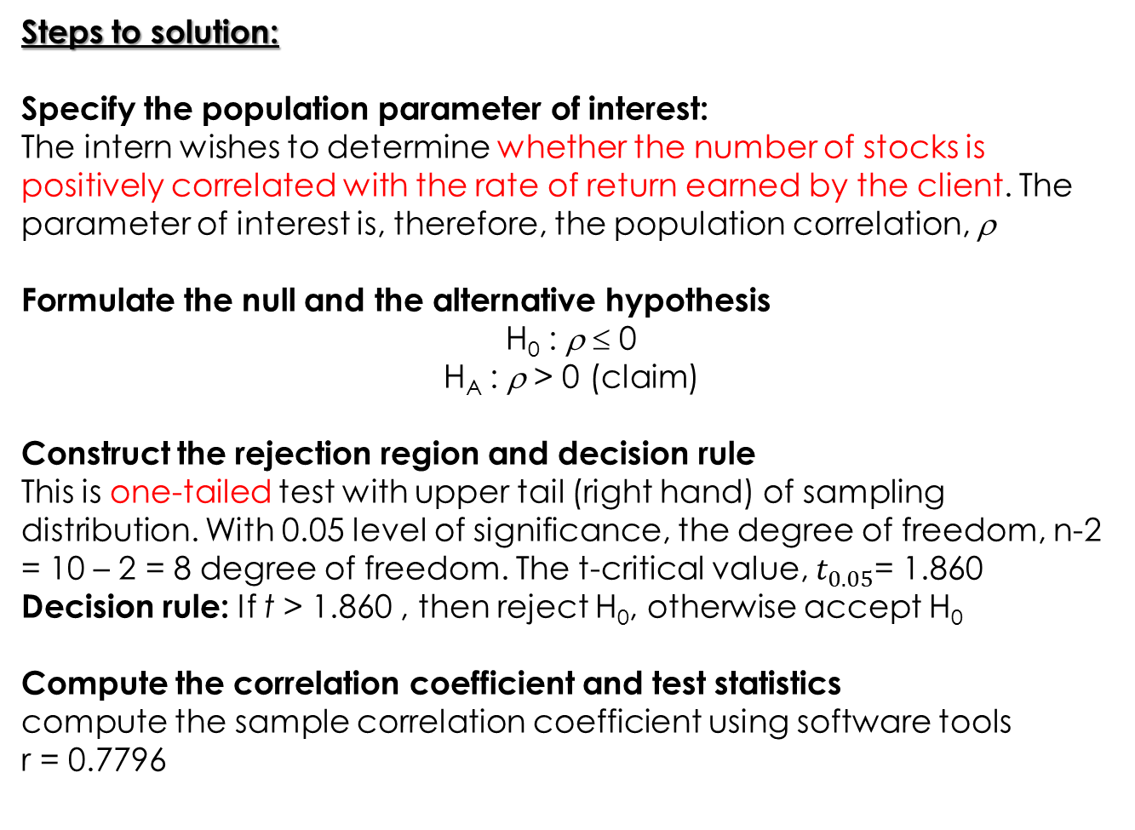
Steps to solution:
Specify the population parameter of interest:
The intern wishes to determine whether the number of stocks is positively correlated with the rate of return earned by the client. The parameter of interest is, therefore, the population correlation, ρ
Formulate the null and the alternative hypothesis
H₀ : ρ ≤ 0
H_{A} : ρ > 0 (claim)
Construct the rejection region and decision rule
This is one-tailed test with upper tail (right hand) of sampling distribution. With 0.05 level of significance, the degree of freedom, n-2 = 10 – 2 = 8 degree of freedom. The t-critical value, $t_{0.05}$= 1.860
Decision rule: If t > 1.860 , then reject H₀, otherwise accept H₀
Compute the correlation coefficient and test statistics
compute the sample correlation coefficient using software tools
r = 0.7796

Slide 11
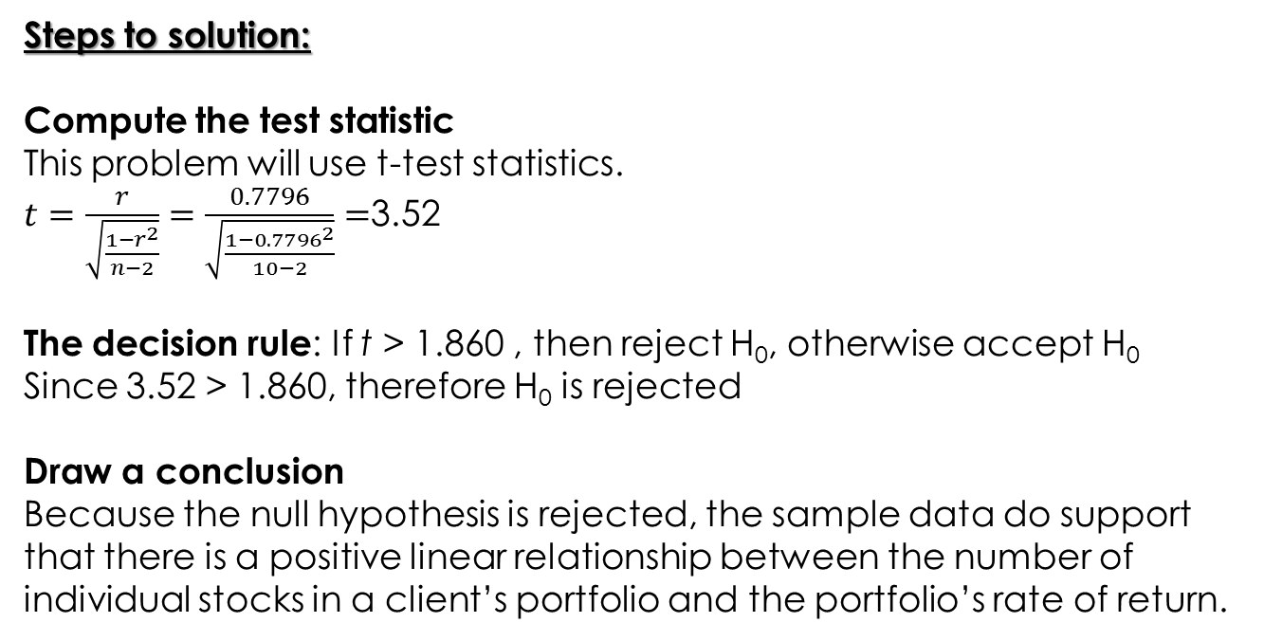
Steps to solution:
Compute the test statistic
This problem will use t-test statistics.
$t=\frac{r}{\sqrt{\frac{1−r^{2}}{n−2}}}=\frac{0.7796}{\sqrt{\frac{1−{0.7796}^{2}}{10−2}}}=$3.52
The decision rule: If t > 1.860 , then reject H₀, otherwise accept H₀
Since 3.52 > 1.860, therefore H₀ is rejected
Draw a conclusion
Because the null hypothesis is rejected, the sample data do support that there is a positive linear relationship between the number of individual stocks in a client’s portfolio and the portfolio’s rate of return.

Slide 12
CORRELATION ANALYSIS- EXAMPLE (R-programming)
The investment firm Harmonic Investments wants to manage the pension fund of a major Chicago retailer. For their presentation to the retailer, the Harmonic analysts want to use correlation analysis to know the relationship between profits and number of employees for 50 Fortune 500 companies in the firm’s portfolio. The data for the analysis are contained in the file Fortune50.
SOLUTION:
Scatter plot for independent and dependent variable
y axis (dependent) – profits; x axis (independent) – employees
Significance test for the correlation and calculate the correlation coefficient (pearson product moment correlation or r-value)
Significance test: To test either is there any relationship between variable “Profits” with variable “Employees”.
r-value: to see the strength of the relationship

Slide 13
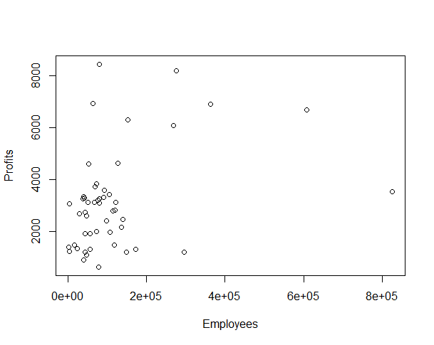
> plot(Profits ~ Employees, data=Fortune50)
summary: scatter plot shown fairly linear relationship

Slide 14
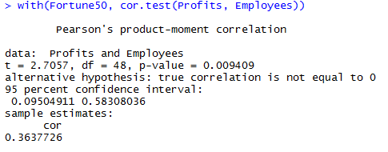
Formulate the null and the alternative hypothesis
H₀ : ρ = 0
H_{A} : ρ ≠ 0 (claim)
correlation coefficient value:
r = 0.363 indicate weak positive linear relationship
p-value < α = 0.05, therefore, reject H₀ which indicate there is a correlation (relationship) between the variables

Slide 15
SIMPLE LINEAR REGRESSION ANALYSIS

Slide 16
THE REGRESSION MODEL & ASSUMPTIONS
Statistical method which is used to analyze the relationship → Regression Analysis
When we have 2 variables → referred to simple regression analysis
When the 2 variables (independent & dependent) have linear relationship → referred as simple linear regression

Slide 17
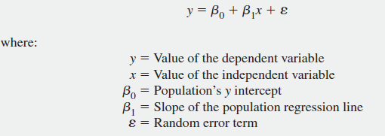
THE REGRESSION MODEL & ASSUMPTIONS
Linear Component
Random error component
- maybe positive, zero or negative

Slide 18
THE REGRESSION MODEL & ASSUMPTIONS
β₁(slope): can be either positive, zero or negative.
Example:
if (β₁=12), it indicate that for a 1 unit increase in x we can expect an average 12 unit increase in y
if (β₁=-12), it indicate that for a 1 unit decrease in x we can expect an average 12 unit decreases in y
Population regression coefficient

Slide 19
THE REGRESSION MODEL & ASSUMPTIONS
β₀(intercept):
- The population’s y intercept, indicates the mean value of y when x is 0.

Slide 20
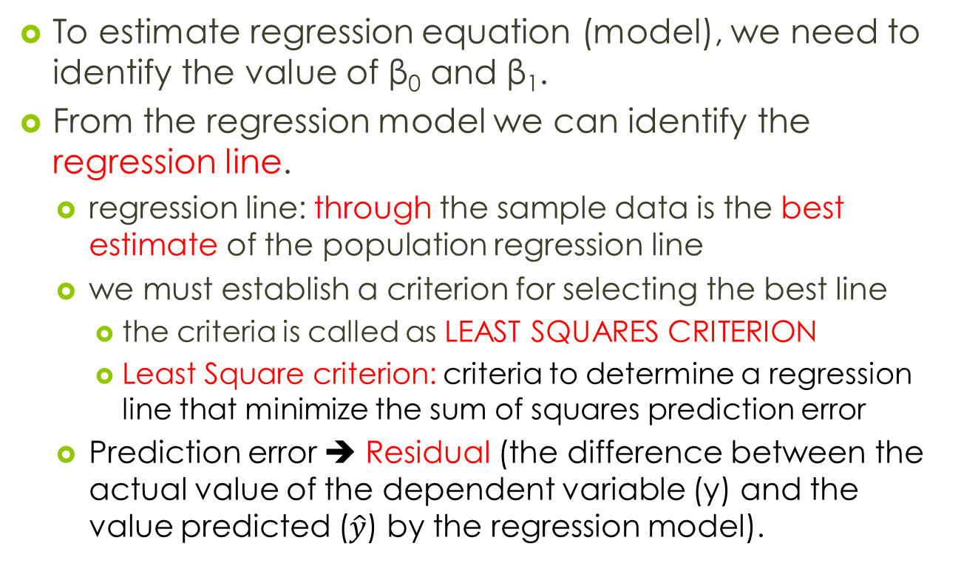
REGRESSION ANALYSIS
To estimate regression equation (model), we need to identify the value of β₀ and β₁.
From the regression model we can identify the regression line.
regression line: through the sample data is the best estimate of the population regression line
we must establish a criterion for selecting the best line
the criteria is called as LEAST SQUARES CRITERION
Least Square criterion: criteria to determine a regression line that minimize the sum of squares prediction error
Prediction error ➔ Residual (the difference between the actual value of the dependent variable (y) and the value predicted ($\hat{y}$) by the regression model).

Slide 21
Possible regression line - We must establish a criterion for selecting the best line (least square criterion)

Slide 22
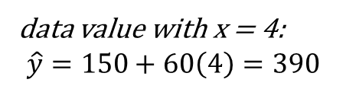
REGRESSION ANALYSIS
data value with x = 4:
$$\hat{y}=150+60\left(4\right)=390$$

Slide 23
RESIDUAL ANALYSIS
an example of manual calculation for residual

Slide 24
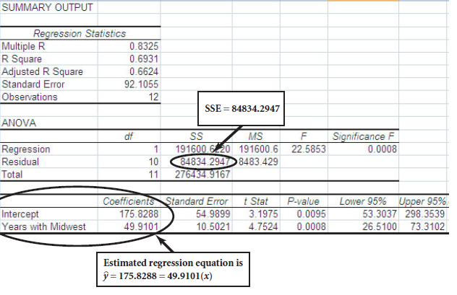
Figure: an example of computer calculation for regression

Slide 25
SIMPLE REGRESSION ANALYSIS- EXAMPLE (R-programming)
The investment firm Harmonic Investments wants to manage the pension fund of a major Chicago retailer. Correlation analysis have been done and it shows that the relationship between profits and number of employees for 50 Fortune 500 companies in the firm’s portfolio are positive linear relationship. Next, the Harmonic wants to use simple linear regression analysis for their presentation to the retailer. The data for the analysis are contained in the file Fortune50.
SOLUTION:
Identify independent (x) and dependent (y) variable
Calculate the correlation coefficient (r) and the linear regression equation/model

Slide 26
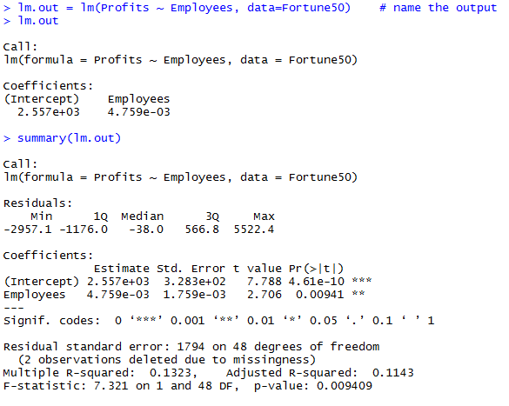
Regression Analysis
β₁ - slope
β₀ - intercept
regression coefficient
The regression equation is $\hat{y}=2557.00+0.00475x$

Slide 27
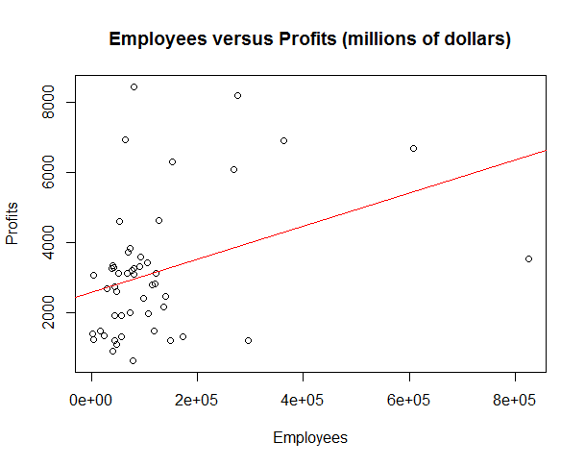
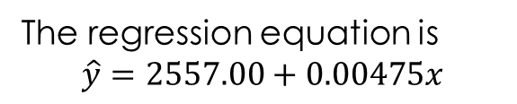
The regression equation is
$$\hat{y}=2557.00+0.00475x$$
> plot(Profits ~ Employees, data=Fortune50, main="Employees versus Profits (millions of dollars)")
> abline(lm.out, col="red")

Slide 28
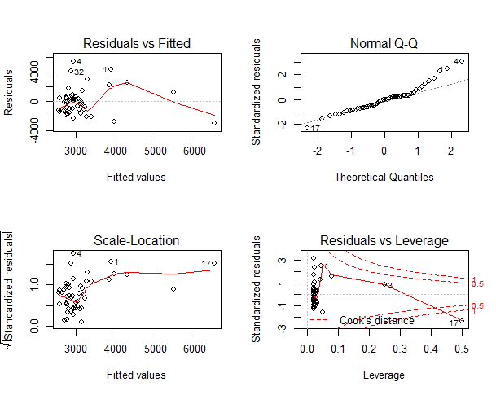
> par(mfrow=c(2,2)) # partition the graphics device
> plot(lm.out)

Slide 29
REGRESSION ANALYSIS PLOT
Other graphic display of how good the model fit is can be achieved as follows:
Residual vs fitted - Points that tend towards being outliers are labeled
Normal Q-Q - to see our residuals normally distributed
Residual vs Leverage - Labeled points on this plot represent cases we may want to investigate as possibly having undue influence on the regression relationship.

Slide 30
SIGNIFICANCE TEST IN REGRESSION ANALYSIS
Why need significance test?:
Regression coefficient compute from sample data is point estimate. Thus, it subject to sampling error.
There are 3 equivalent significant test in regression analysis:
Test for significance of the correlation between x and y. ---- cover in correlation analysis
Test for significance of the coefficient of determination. ---- next slide
Test for significance of the regression slope coefficient. ---- next next slide ☺

Slide 31


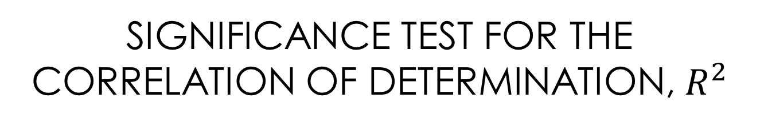
SIGNIFICANCE TEST FOR THE CORRELATION OF DETERMINATION, $R^{2}$
Coefficient of Determination, $R^{2}$:
The portion of the total variation in the dependent variable that is explained by its relationship with the independent variable.

Slide 32
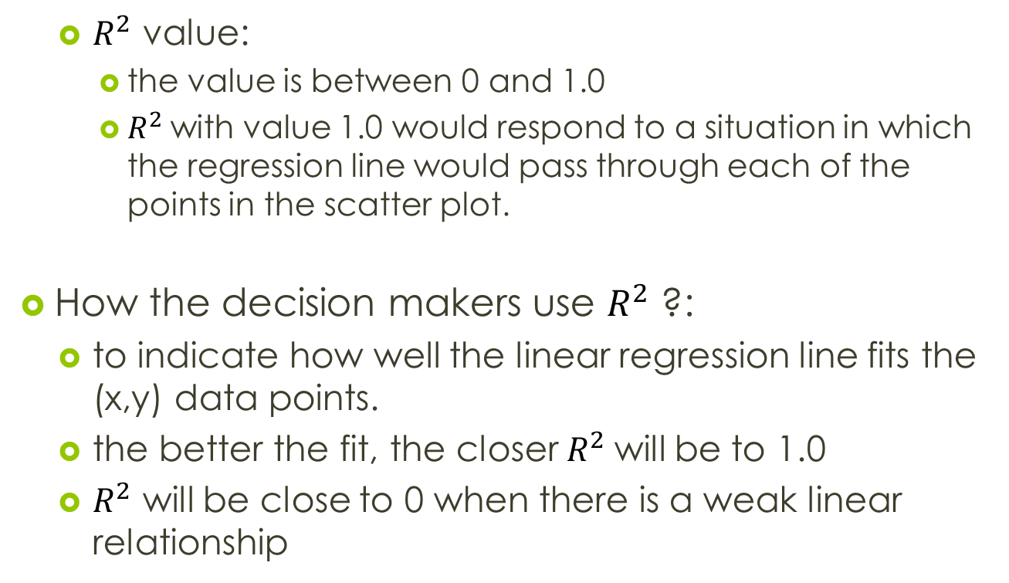
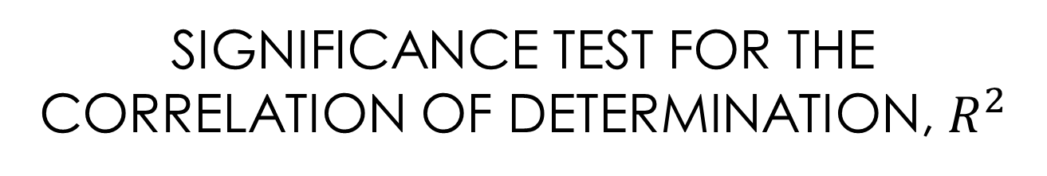
SIGNIFICANCE TEST FOR THE CORRELATION OF DETERMINATION, $R^{2}$
$R^{2}$ value:
the value is between 0 and 1.0
$R^{2}$with value 1.0 would respond to a situation in which the regression line would pass through each of the points in the scatter plot.
How the decision makers use $R^{2}$ ?:
to indicate how well the linear regression line fits the (x,y) data points.
the better the fit, the closer $R^{2}$will be to 1.0
$R^{2}$ will be close to 0 when there is a weak linear relationship

Slide 33

SIGNIFICANCE TEST FOR THE CORRELATION OF DETERMINATION, $R^{2}$
Others measurements in Regression Analysis:
SST (total sum of squares): used to measure variation in the dependent variable (y).
SSR (sum of square regression): used to measure variation attributed to the relationship between the x's and y's
SSE (sum square errors): used to measure the variation attributed to the error. It should be minimize

Slide 34
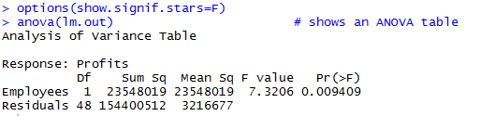
example from data set Fortune50
SSE
SSR
SST = SSR + SSE

Slide 35
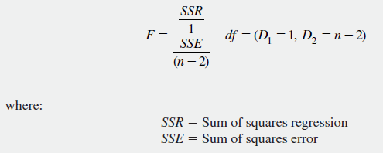
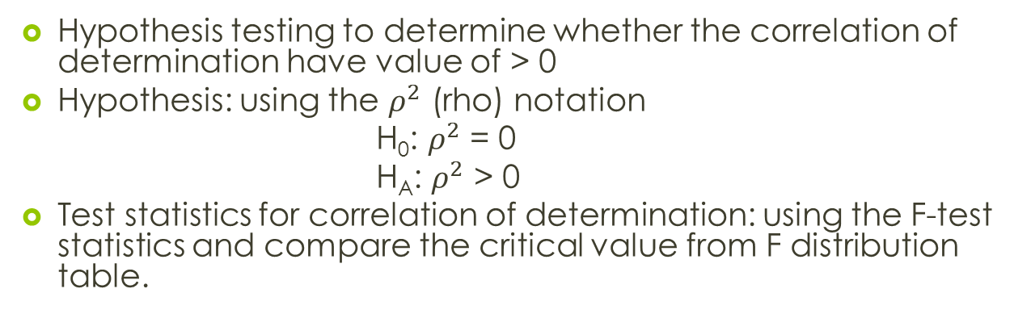

SIGNIFICANCE TEST FOR THE CORRELATION OF DETERMINATION, $R^{2}$
Hypothesis testing to determine whether the correlation of determination have value of > 0
Hypothesis: using the $ρ^{2}$ (rho) notation
H₀: $ρ^{2}$ = 0
H_{A}: $ρ^{2}$ > 0
Test statistics for correlation of determination: using the F-test statistics and compare the critical value from F distribution table.
Test Statistic for Significance of the Coefficient of Determination

Slide 36
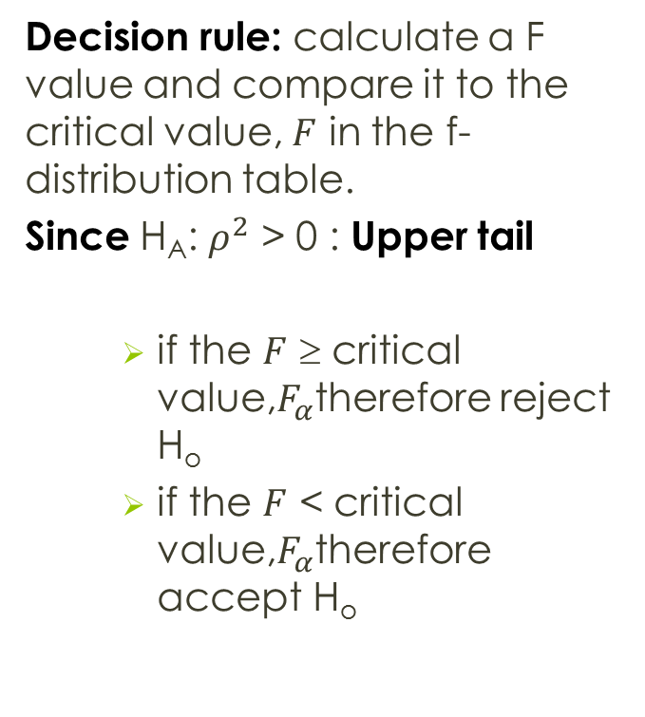
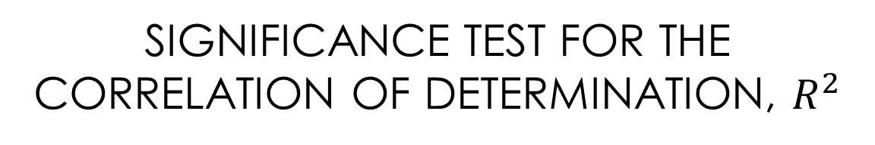
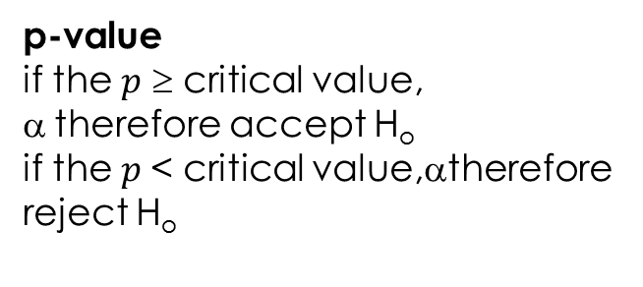
SIGNIFICANCE TEST FOR THE CORRELATION OF DETERMINATION, $R^{2}$
Decision rule: calculate a F value and compare it to the critical value, $F$ in the f-distribution table.
Since H_{A}: $ρ^{2}$ > 0 : Upper tail
if the $F$ ≥ critical value,$F_{α}$therefore reject H_{o}
if the $F$ < critical value,$F_{α}$therefore accept H_{o}
p-value
if the $p$ ≥ critical value, α therefore accept H_{o}
if the $p$< critical value,$\text{}$therefore reject H_{o}

Slide 37
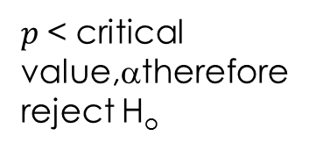
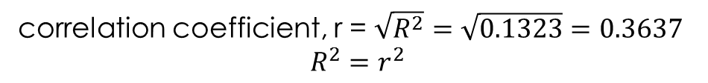

example from data set Fortune50
$p$< critical value,$\text{}$therefore reject H_{o}
$R^{2}$ value
correlation coefficient, r = $\sqrt{R^{2}}=\sqrt{0.1323}=0.3637$
$$R^{2}=r^{2}$$

Slide 38

example from data set Fortune50
The F-value and the p-value for testing coefficient of determination, $R^{2}$
Decision: P-value < α = 0.05, therefore H₀ is rejected

Slide 39

example from data set Fortune50
Conclusion:
We reject the null hypothesis and conclude the population coefficient of determination ($ρ^{2}$) is greater than zero. This mean the independent variable (x) explains a significant proportion of the variation in the dependent variable (y)

Slide 40

SIGNIFICANCE TEST OF THE REGRESSION SLOPE COEFFICIENT
Why need to test the regression slope coefficient?
we are interested in determining whether the population regression slope coefficient is 0.
A slope of 0 would imply that there is no linear relationship between x and y variables and that the x variable
Hypothesis null and alternative to be tested are:
H₀: $β_{1}$ = 0
H_{A}:$β$₁ ≠ 0

Slide 41
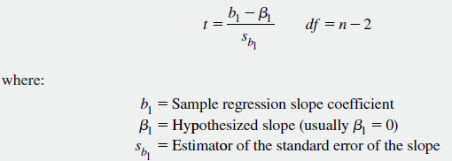
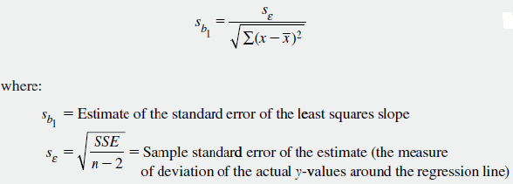
Simple Linear Regression Test Statistic for Test of the Significance of the Slope
Simple Regression Estimator for the Standard Error of the Slope

Slide 42
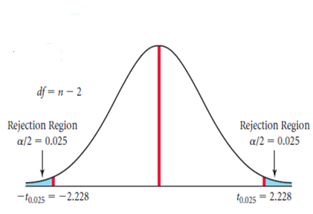
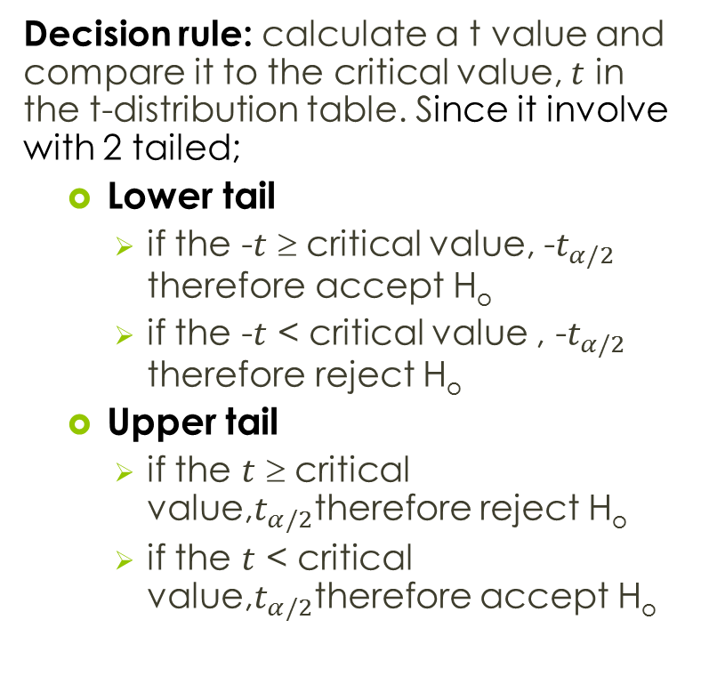
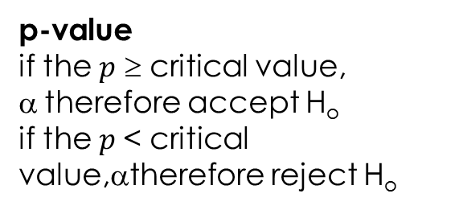
SIGNIFICANCE TEST OF THE REGRESSION SLOPE COEFFICIENT
Decision rule: calculate a t value and compare it to the critical value, $t$ in the t-distribution table. Since it involve with 2 tailed;
Lower tail
if the -$t$ ≥ critical value, -$t_{α/2}$ therefore accept H_{o}
if the -$t$ < critical value , -$t_{α/2}$ therefore reject H_{o}
Upper tail
if the $t$ ≥ critical value,$t_{α/2}$therefore reject H_{o}
if the $t$ < critical value,$t_{α/2}$therefore accept H_{o}
p-value
if the $p$ ≥ critical value, α therefore accept H_{o}
if the $p$< critical value,$\text{}$therefore reject H_{o}

Slide 43
example from data set Fortune50
standard error of the regression slope = 0.00176
the calculated t-statistics and p-value for testing whether the regression slope = 0

Slide 44
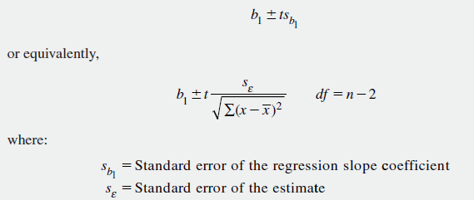
CONFIDENCE INTERVAL ESTIMATE FOR THE REGRESSION SLOPE
Why need confidence interval estimate for β₁?
to describe the relationship between the independent variable and the dependent variable.
Confidence Interval Estimate for the Regression Slope, Simple Linear Regression

Slide 45
PROBLEM:
In the summer of 2006, gasoline prices soared to record levels in the United States, heightening motor vehicle customers’ concern for fuel economy. Analysts at a major automobile company collected data on a variety of variables for a sample of 30 different cars and small trucks. Included among those data were the Environmental Protection Agency (EPA)’s highway mileage rating and the horsepower of each vehicle. The analysts were interested in the relationship between horsepower (x) and highway mileage (y). The data are contained in the file Automobiles.
Identify the following:
Correlation coefficient analysis
Regression coefficient
Regression equation model
Regression plot
Test for significance of the correlation between x and y at 95%
Test for significance of the coefficient of determination at 95%
Test for significance of the regression slope coefficient at 95%
Confidence interval estimate for the regression slope at 95%

Slide 46
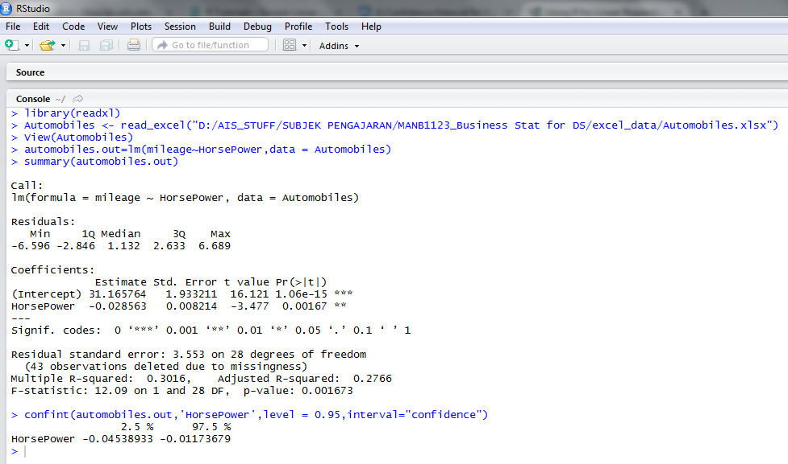

Slide 47
Summary for CI estimate for regression slope:
Thus, at the 95% confidence level, based on the sample data, the analysts for the car company
can conclude that a 1-unit increase in horsepower will result in a drop in mileage by an average amount between 0.012 and 0.045 miles per gallon.

Slide 48
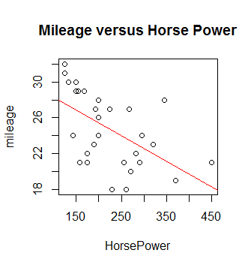

Slide 49
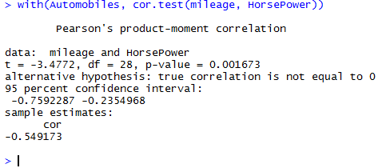
Solution via R-programming

Slide 50
THANK YOU
Do more exercise!!!!

